Slide 1
Disease Prediction
Leveraging Symptoms for Proactive Healthcare Solutions
~GROUP-11

Slide 2
Introduction
In today's fast-paced world, people often neglect their health due to busy schedules. Symptoms that could be early indicators of serious diseases are frequently ignored or misinterpreted. This negligence can lead to late diagnosis, severe complications, or even fatal consequences.
This project focuses on building a Disease Prediction System using Machine Learning. By inputting common symptoms, the system predicts possible diseases a person might be suffering from. It aims to assist individuals and healthcare professionals in identifying potential illnesses at an early stage, enabling timely treatment and intervention.

Slide 3
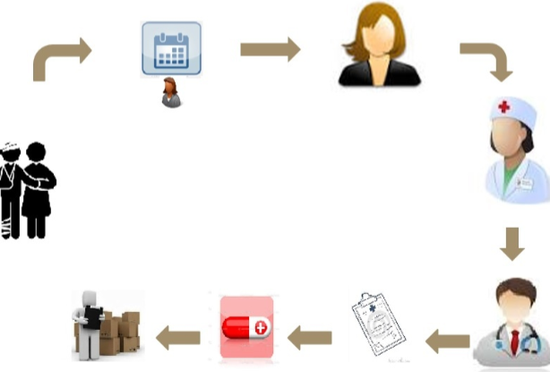
Objective
The main objective of this project is to develop an intelligent disease prediction system that can:
Predict the most probable disease based on user-input symptoms
Utilize machine learning algorithms for accurate classification
Provide a user-friendly interface for symptom input and result display
Support early detection and improve decision-making in healthcare
Assist both medical professionals and non-experts in identifying possible illnesses quickly and efficiently
Ultimately, the project aims to combine data science and healthcare to make diagnosis faster, smarter, and more accessible.

Slide 4
01
Problem Statement
Many individuals are unable to recognize the seriousness of their symptoms due to lack of awareness or time constraints. In crowded healthcare systems, doctors are also overwhelmed and may not always have the time to analyze symptoms deeply for every patient.
Thus, there is a growing need for an intelligent, symptom-based disease prediction system that can:
Quickly analyze given symptoms
Suggest possible diseases
Support the diagnostic process without replacing doctors

Slide 5

Overview of Disease Prediction
Disease prediction using symptoms is a crucial area in healthcare that aims to identify potential medical conditions based on the manifestation of various signs and symptoms in patients. Leveraging machine learning algorithms and data analysis, this approach enhances early detection and treatment possibilities.

Slide 6
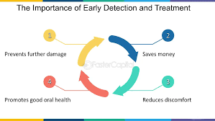
Importance of Early Detection
Early detection of diseases significantly improves treatment outcomes and can reduce healthcare costs. Predicting diseases based on symptoms allows for timely interventions, healthcare professionals can manage conditions proactively, preventing complications and enhancing patient quality of life.

Slide 7
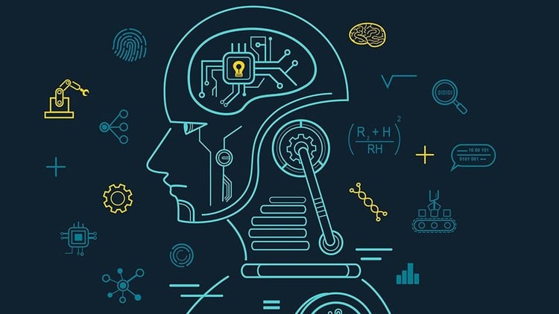
Challenges in Symptom-Based Prediction
While developing the system, the following challenges were encountered:
Limited symptom input: Predictions may lack accuracy with too few symptoms.
Overlapping symptoms: Many diseases share similar signs, causing confusion.
Data dependency: Quality and completeness of data strongly impact results.
Scalability: The desktop-based GUI may not be suitable for large-scale or mobile deployment.
Interpretability: Users might not fully understand the technical predictions.

Slide 8
02
Methodology
Our disease prediction system follows a structured machine learning workflow. The objective is to predict the most probable disease based on symptoms provided by a user. Here's a step-by-step breakdown:
The system uses four supervised machine learning algorithms:
Decision Tree – builds a tree-like model of decisions.
Random Forest – combines multiple decision trees to improve accuracy.
Naïve Bayes – uses probabilistic methods based on Bayes' Theorem.
k-Nearest Neighbors (kNN) – classifies based on proximity to known data.

Slide 9
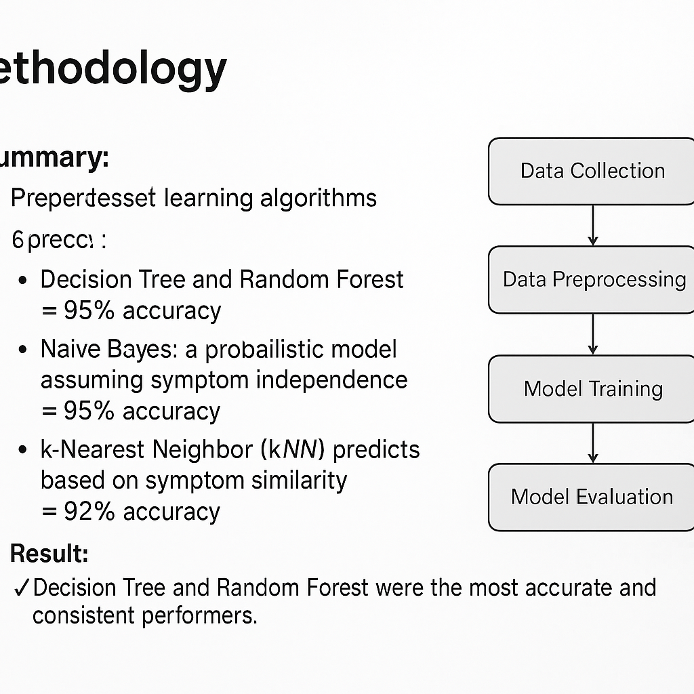
Steps followed:
Data was collected from a healthcare study at Columbia University.
Data preprocessing included cleaning, handling missing values, and encoding.
Models were trained and tested on the dataset.
Accuracy and performance were evaluated using standard metrics.

Slide 10
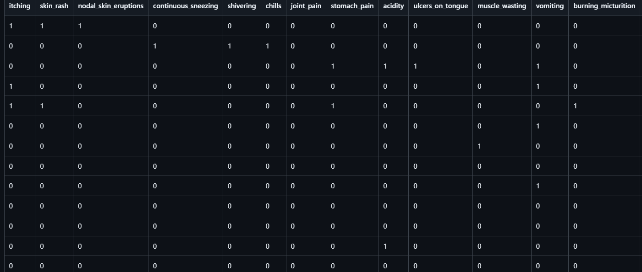
Data Collection Methods
The dataset was obtained from the DiseaseSymptomKB project by Columbia University.
It contains a structured mapping of diseases and their associated symptoms.
Data includes:
Multiple diseases across various categories
Sets of symptoms linked to each disease
Format:
Stored as structured text or CSV files
Each row represents a disease instance, with symptoms as features
✅ This high-quality dataset provided a strong foundation for training accurate and reliable machine learning models.

Slide 11
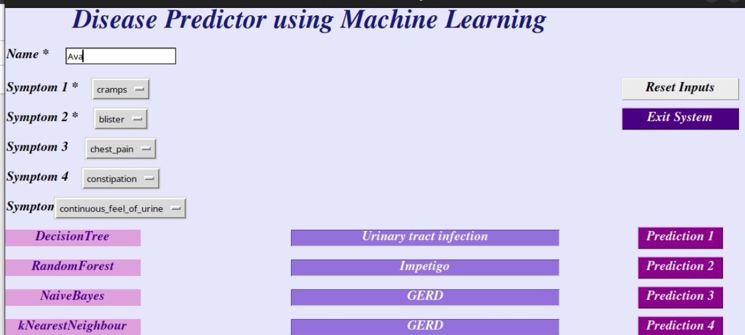
Implementations
Programming Language: Python
Libraries: pandas, numpy, scikit-learn, tkinter
The GUI allows users to:
Enter their name and select at least two symptoms.
Click on a button for each algorithm to get a disease prediction.
View the result in a text field.
Each button (Prediction 1–4) represents a different algorithm. The application is simple to use and helpful for non-technical users.

Slide 12
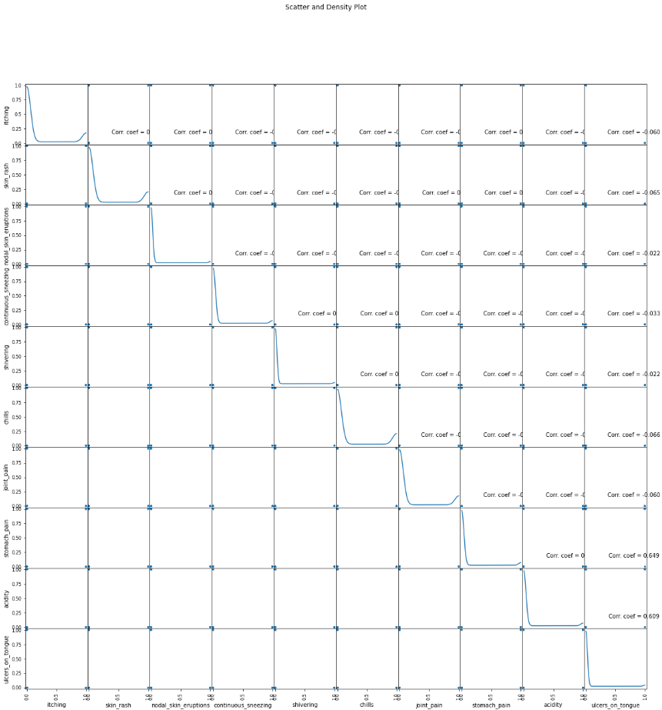

Slide 13

Results
The system achieved impressive accuracy levels across all models:
Decision Tree: ~95%
Random Forest: ~95%
Naïve Bayes: ~95%
kNN: ~92%
The interactive GUI allowed users to easily enter symptoms and get predictions. Visual results and accuracy metrics confirmed the effectiveness of the system.

Slide 14
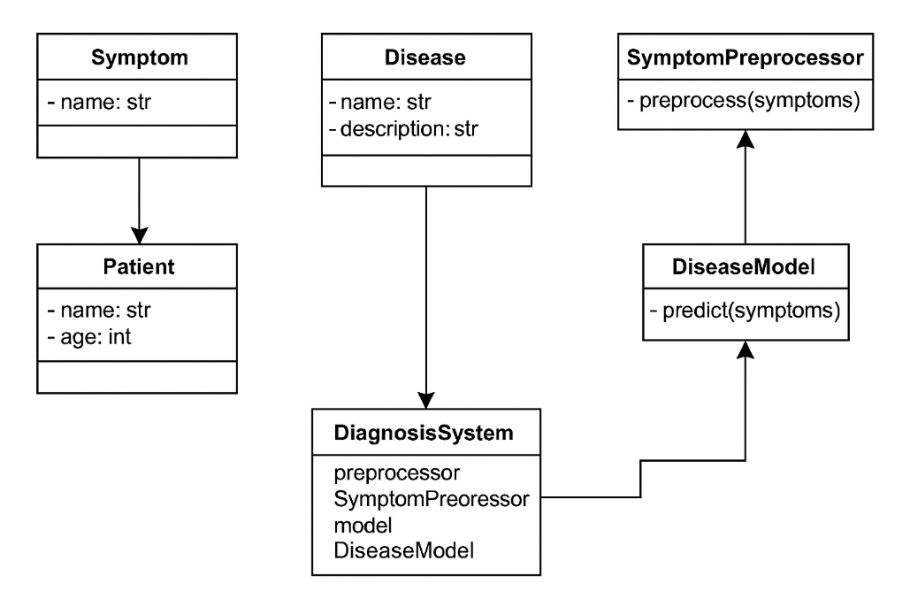
Class Diagram

Slide 15
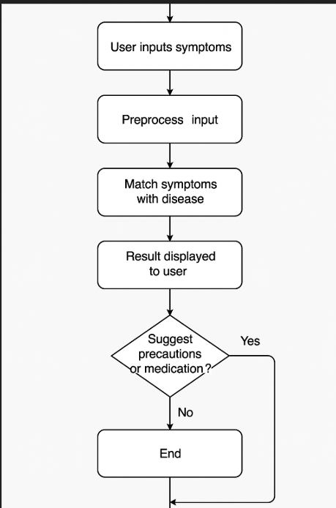
Activity Diagram

Slide 16
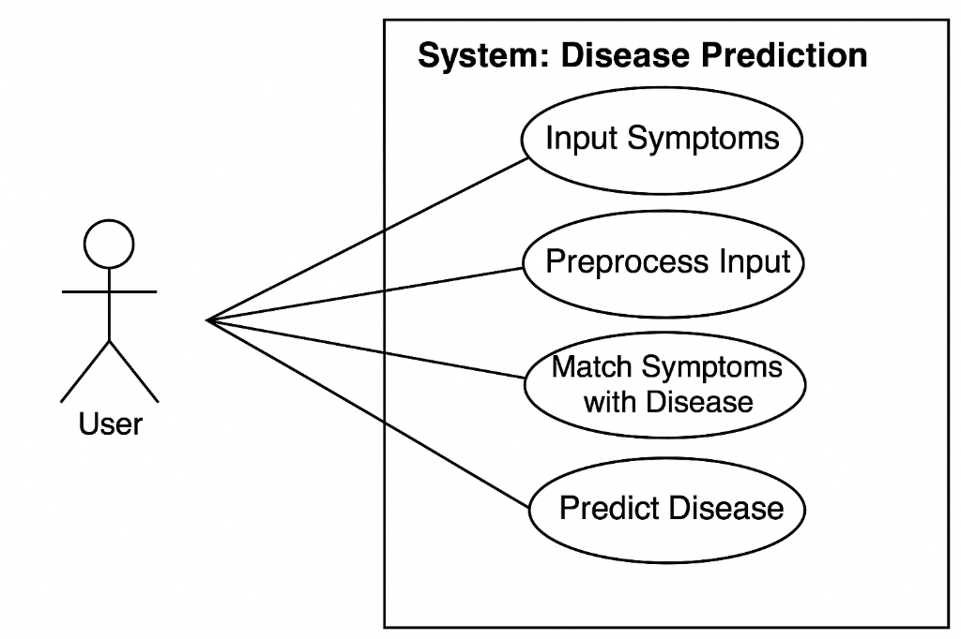
UML Diagram

Slide 17
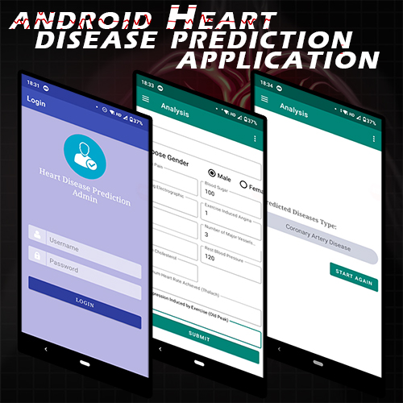
Applications
This system can be used in various real-world scenarios:
Hospitals and Clinics: As an initial triage tool for doctors.
Telemedicine platforms: For remote patient consultations.
Rural Health Kiosks: For areas with limited medical staff.
Mobile Apps: For users to self-check symptoms anytime, anywhere.
Chatbots: Integrated into digital health assistants for smarter conversations.

Slide 18

Future Work
The system can be further improved by:
Expanding the dataset to include more symptoms and rare diseases.
Incorporating patient history and demographic details.
Deploying it as a mobile or web application for wider access.
Supporting voice inputs and multi-language interfaces.
Using real-time learning from new inputs to enhance predictions continuously.

Slide 19
Conclusions
This project successfully demonstrates how machine learning can be applied to healthcare for symptom-based disease prediction. By using algorithms like Decision Tree, Random Forest, Naïve Bayes, and kNN, we built a model capable of predicting diseases with high accuracy using just a few user-reported symptoms.
The system:
Is easy to use, thanks to the interactive GUI built with Python’s Tkinter.
Delivers quick predictions, which can be valuable in emergency or remote settings.
Helps in early detection, supporting timely treatment and improving outcomes.
Can be used as a diagnostic support tool for doctors or even as a self-check system for individuals.
While it doesn’t replace medical professionals, it acts as a first step toward smarter, AI-assisted healthcare. With further development, it can play a crucial role in both clinical and non-clinical environments.

Slide 20
GitHub link
https://github.com/Avanti1729/BDAProject

Slide 21
Thank
you!

